Slide 1
Renaissance and Reformation in Europe
Dr. Md. Faruk Shah
Adjunct Faculty Member
Department of History and Philosophy
North South University

Slide 2

Lecture Outline
Meaning and Characteristics of Renaissance
Spirits of the Renaissance
Arts and Literature of the Renaissance
Impacts of the Renaissance
Relation between the Renaissance and Modernity
https://www.youtube.com/watch?v=UsKSB-aT3ys

Slide 3
Meaning of Renaissance
Renaissance is a French word meaning rebirth.
Scholars reacted against “dark ages" and revived the learning of Greece & Rome.
The Renaissance was a period of cultural, artistic, political and economic “rebirth”.
The Renaissance was one avenue to modernity; another was the reformation.
Great achievements in the arts and sciences were combined with deep religious concerns.
Individuals showed an increasing concern for worldly life & an attitude to modernity.
By 16th century, Europeans had established the foundations for modern Europe.

Slide 4
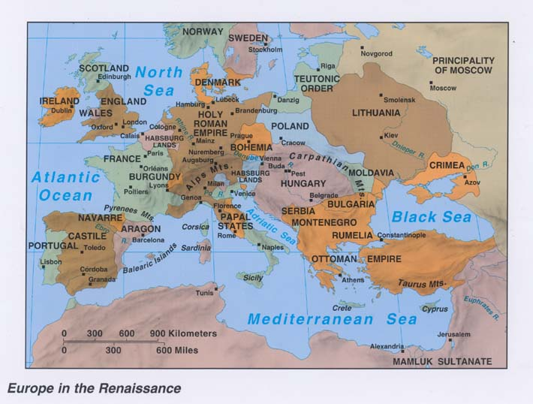

Slide 5
Spirits of the Renaissance: The Italian City States
Many towns expanded into city states.
Each city-state governed itself and the surrounding countryside.
Such independence left the rulers of the city-states free to experiment in government as well as in the larger world of ideas.
Merchants and bankers made up a powerful middle class in the Italian city-states.
Renaissance reflected for education and individual achievement.

Slide 6
Spirits of the Renaissance: Study of the Humanities
Developed a renewed interest in education.
Stressed the importance of humanities.
The humanities included grammar, rhetoric, poetry, and history.
Human reason and logic were as important in understanding the world.
Rediscovered knowledge that had been lost or forgotten.
Education was the way to become a well-rounded individual.
This philosophy reflected the Renaissance confidence in individual abilities.

Slide 7
Spirits of the Renaissance: Recovering the Classics
Scholars recovered writings of classical world.
Developed techniques for analyzing historical documents.
While searching for classical texts, Renaissance humanists rescued many hidden treasures.
Francesco Petrarch (1304-1374), a Renaissance writer and humanist, collected Greek and Roman writings, like the poetry of Virgil and Homer and wrote secular poetry about love and life.

Slide 8
Spirits of the Renaissance: Handbooks for Proper Behavior
Writers prepared manuals that guided individuals how to behave.
People were more concerned with achieving worldly success.
In The Prince, Machiavelli recommended that a ruler adopt a realistic course of action in order to stay in power.
Castiglione in The Book of the Courtier described the qualities that a courtier, educated aristocrat, should possess.

Slide 9
Arts and Literature of the Renaissance: Classical Influence
Artists returned to the classical principles of Greek and Roman art.
Returned to the Greeks who stressed harmony and balance in nature, and the Romans emphasized realism.
Found inspiration in ancient Roman buildings scattered across the land.
Wealthy popes and princes patronized many painters and sculptures who incorporated secular and classic themes into religious topics.

Slide 10
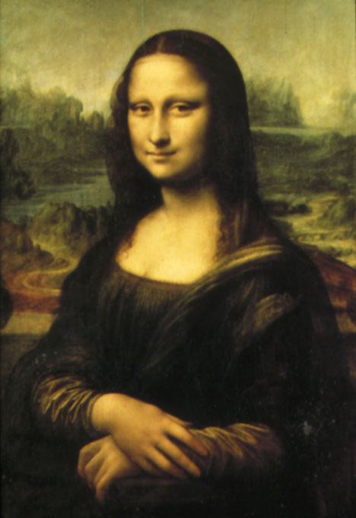
Arts and Literature of the Renaissance: New Techniques in Art
Many Renaissance artists tried to show the world realistically,
as it actually existed.
Artists made significant contributions to Renaissance art by
improving paints.
During 1500s, three artists dominated the world of
Italian art: Leonardo da Vinci, Michelangelo, and Raphael Santi.

Slide 11
Arts and Literature of the Renaissance: Renaissance Writers
Literature expressed the attitude of renaissance.
In towns and cities, the middle class formed a demanding new audience.
Erasmus wrote “Praise of Folly” which ridiculed the church, corrupt officials, and Clergy.
Both well-to-do and poorer people attended the theater.

Slide 12
Arts and Literature of the Renaissance: A Call for Reform
Writers emphasized on religious and worldly themes.
In the early 1500s, some Christian scholars who had made a study of the Bible and early Christian writings urged reform of the Church to return to its early traditions based on the teachings of Jesus.

Slide 13
Changing Patterns of Life…
Few people were directly affected by the outpouring of creative genius in literature and the arts.
The wealthy filled their palaces with artistic masterpieces.
They also had the leisure time to read widely and expand their knowledge of the world.
However, in later years, advances in technology gradually helped spread the new learning to a wider audience. As a result, Renaissance learning slowly filtered into the lives of ordinary people.

Slide 14
Changing Patterns of Life: The Introduction of Printing
Johannes Gutenberg invented the moveable type printing press.
Printing dramatically affected the production of books.
Europeans learned from the Arabs how to make paper and by 1500, there were over 250 presses in Europe turning out books.
As printing methods improved, the cost of producing books fell.
People who could never have afforded hand-copied books now bought printed books.
The use of paper and the development of printing had a revolutionary impact on the world of learning.
Ideas spread rapidly through the printed word.

Slide 15
Changing Patterns of Life: Everyday Life
The nuclear family gradually began to emerge, especially in the towns and cities.
In a nuclear family, only parents and their children live in a household.
Some people formed business partnerships with people outside the family.
When employers tried to keep wages low, the workers revolted.
The wages of city workers did rise during the Renaissance.

Slide 16
Changing Patterns of Life: Women in Renaissance
Women started to work outside the home.
Some women were employed as servants in households of wealthy farmers, merchants, or nobles.
Many women also earned money as spinners and weavers.
Women in the merchant class helped manage family businesses.
Women ran their own small businesses, selling handwork or garden product at local markets.
Women also played central roles in governing city states or nations.

Slide 17
Changing Patterns of Life: A Revolution in Political Thought
Rulers derived their power from God, However-
Machiavelli saw it as a natural entity; politics had nothing to do with God’s intent
In secularizing and rationalizing political philosophy, he initiated a trend of thought that we recognize as distinctly modern.

Slide 18
The Renaissance and Modernity
Economy: commerce and industry expanded greatly, and capitalism largely
replaced medieval forms of economic organization.
Political: central government grew stronger at the expense of feudalism.
Social: middle-class towns people, increasing in number and wealth, began to play a more important role in economic and cultural life.
Cultural: the clergy lost its monopoly over learning
Theology: the queen of knowledge in the Middle Ages, surrendered its crown to science, and reason

Slide 19

Trade:
Created a wealthy class
who became patrons
of the arts.
Individualism:
Emphasis on the importance
of the individual and achievements.
Classicism:
Revival of Greek & Roman
achievements & writings.
Questioning
Spirit
Humanism:
Glorification of people
& human reason.
Renaissance
Secularism:
Other than religion.
Intellectual &
Artistic Creativity

Slide 20
Thank You and Questions???

